Slide 1
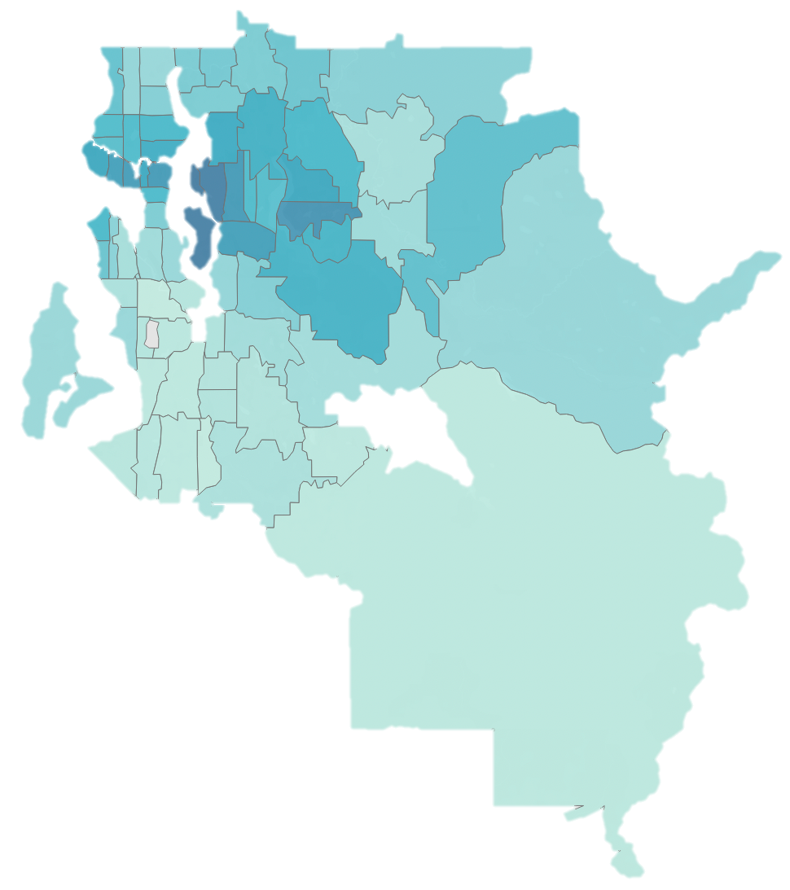

Seattle

Slide 2

Biggest Drivers of Home Price
Total Square Feet
Grade
View
Home Age
Condition
POSITIVE
Bathrooms
Waterfront
Renovated
Lot Square Feet
Floors
NEGATIVE
Bedrooms
Basement

Slide 3
Recommendation: Finish a Basement
with 700 sqft and High-Grade Construction
+$21,000
$81,000
+$84,000
Having a Basement
$0
Grade 9 Construction
Total Value Added
-$24,000
Adding 700 sqft

Slide 4
Recommendation: Add a Full-Size Bathroom
with 60 sqft and High-Grade Construction
+$21,000
$43,200
+$7,200
+$15,000
$0
Adding a Bathroom
Adding 60
sqft
Grade 9 Construction
Total Value Added

